Slide 1
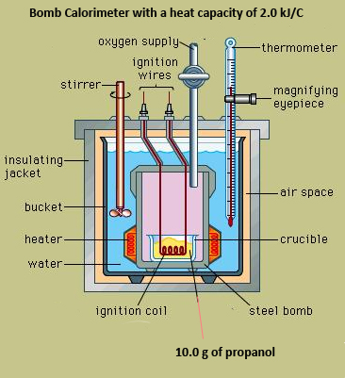
Measuring Energy Changes in a Chemical Reaction
Calorimetry
2017

Slide 2
Key concept:
EVERY chemical reaction either releases energy to the surroundings (exothermic reactions) OR absorbs energy from the surrounding (endothermic reactions)
We cannot measure the energy changes in the chemical reaction (the system)
BUT we can easily measure the energy changes in the surroundings
If we assume that:
heat lost/gained by the system = heat gained/lost by the surroundings
then we can experimentally determine the energy changes in chemical reactions

Slide 3
Key concept:
To measure the heat gained/lost by the surroundings we need a device called a calorimeter
Calorimeters can be as simple as a beaker filled with water or as sophisticated as a bomb calorimeter

Slide 4
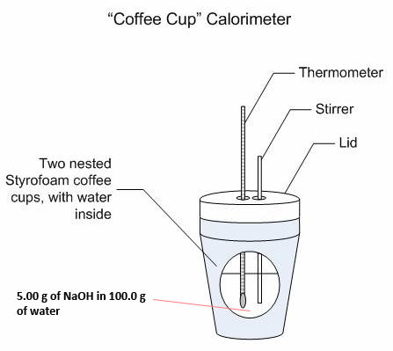
Coffee cup calorimeter
Bomb calorimeter

Slide 5
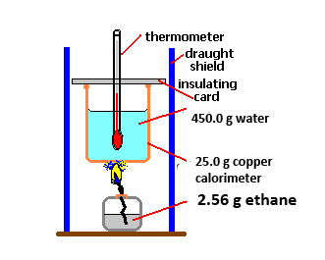
Example 1: What amount of heat is released when 2.56 g of ethane burns?
Assumption:
All heat lost by the reaction goes into the copper calorimeter and the water.
Given:
The temperature of both the copper calorimeter and the water increase by 70.3 ºC
The specific heat capacity of water is 4.18 J/gºC
The specific heat capacity of copper is 0.385 J/gºC

Slide 6
q = mcΔT (can only used for surroundings)
Surroundings: water and copper
Heat gained
q_{water} = mcΔT
=(450g)(4.18J/gºC)(70.3ºC)
= 132234 J
q_{copper} = mcΔT
= (25.0g)(0.385 J/gºC)(70.3ºC)
= 676.6 J
q_{total} = 132911 J = 132.9 kJ
total heat gained = heat lost by system

Slide 7
System: ethane and oxygen
Heat lost
q_{rxn} = 132.9 kJ
This is called the “heat of the reaction”

Slide 8
What amount of heat is released when 1 mole of ethane burns?(units will be kJ/mol)
2.56 g of ethane = _________ mol of ethane
Therefore the heat released/ mol of ethane is: q_{rxn}/n

Slide 9
Now that the units are “standardized” we call this energy change “enthalpy of the reaction”. Rather than using the symbol “q”, we use the symbol “ΔH”.
Since heat has been lost by the system, it is an _________ reaction and we indicate this loss by using the (–)ve sign.
Therefore: ΔH = -1561 kJ/mol

Slide 10
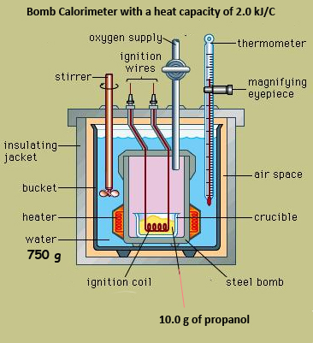
Example 2: What is the heat of the reaction when 10.0g of propane burns?
Given:
The temperature of both the calorimeter and water increases from 25.0ºC to 90.5ºC
The heat capacity of the calorimeter is 2.00 kJ/ºC
The specific heat capacity of water is 4.18 J/gºC

Slide 11
q = mcΔT and q = C ΔT
Surroundings: water and calorimeter System: propane and oxygen
Heat gained Heat released
q_{water} = q_{rxn} =
q_{calorimeter} =
q_{total} =
total heat gained = heat lost by system

Slide 12
What is the molar enthalpy of combustion of propane?
Moles of
Therefore ΔH = _________ = ________ kJ/mol

Slide 13
Example 3: What is the molar enthalpy of dissolution (dissolving) of NaOH?
Given:
Heat absorbed by coffee cup = 0 J
Water temperature increases from 25.0ºC to 38.3ºC
Surroundings: cup and water Heat gained q_{water} = q_{styrofoam} = q_{surroundings} = | System: NaOH and water Heat lost q_{rxn} = n_{NaOH} = ΔH =

Slide 14
q_{solution} = (105.0)(4.18)(13.3)
= 5.84 kJ
q_{rxn} = q_{solution} =
n_{NaOH} =
ΔH = q_{rxn}/n = -46.7 kJ/mol of NaOH

